Slide 1
Design and Analysis of Algorithms Intro to dynamic programming; matrix chain multiplication; longest common subsequence
Slides from Haidong Xue

Slide 2
When is divide-and-conquer inefficient?
In divide-and-conquer, a solution is combined from solutions of subproblems
Mergesort
Quicksort
Maximum-subarray
What if the subproblems are largely overlapped?

Slide 3
When is divide-and-conquer inefficient?
E.g. find out who is the tallest person in this classroom
It may be solved by:
Find out the tallest male
Find out the tallest student
Choose the taller one from these two
What is the problem here?
All the male students are measured twice

Slide 4
What is dynamic programming?
Similar to divide-and-conquer
(When applied to optimization problems, it is called optimal substructure: optimal solution is constructed from optimal solutions to its subproblems)
Subproblems overlap
Subproblems share sub-subproblems
Overlapped subproblems grows quickly with problem size

Slide 5
What is dynamic programming?
Subproblems overlap
Subproblems share sub-subproblems
Sub1
Sub2
Sub3
Sub4
Sub5
Sub4
Sub5
Sub6

Slide 6
What is dynamic programming?
Dynamic programming algorithms
Solve each subproblem only once
If solve problems in a top-down manner, record sub problem solutions in a table (named: top-down with memoization)
If solve the problems in a bottom-up manner, solve the smaller problem first (named: bottom-up method)
In computing, memoization is an optimization technique used primarily to speed up computer programs by having function calls avoid repeating the calculation of results for previously processed inputs.

Slide 7
What is dynamic programming?
Find out who is the tallest person in this classroom
Find out the tallest male
Find out the tallest student
Find the taller one from this two
Assuming there are only these persons here:
Instructor, Haydon, male
Student, Brad, male
Student, Rebecca, female
Student, Eric, male
The problems “measure the height of a person” are highly overlapped
What are the top-down method and bottom-up method of this algorithm?

Slide 8
Top-down
Find out the tallest male:
Check memo for Haydon’s height
Memo
Measure Haydon’s height and record it. Max=(Haydon, 1.75)
Name | Height
Haydon
Brad
Rebecca
Eric
Check memo for Brad’s height
1.75m
Measure Brad’s height and record it. Max=(Brad, 1.8)
1.80m
Check memo for Eric’s height
1.73m
Measure Eric’s height and record it. Max=(Brad, 1.8)
1.78m
Return (Brad, 1.8)
Find out the tallest student:
Check memo for Brad’s height. Max=(Brad, 1.8)
How many times we measure the height?
Check memo for Rebecca’s height.
Measure Rebecca’s height and record it. Max=(Brad, 1.8)
4
Check memo for Eric’s height. Max=(Brad, 1.8)
Return (Brad, 1.8)
Choose the taller one from tallest male and tallest student
Return (Brad, 1.8)

Slide 9
Bottom-up
Solve all the subproblems from smaller ones to bigger ones
Measure Haydon’s height and record it.
Memo
Measure Brad’s height and record it.
Name | Height
Haydon
Brad
Rebecca
Eric
Measure Rebecca’s height and record it.
1.75m
Measure Eric’s height and record it.
1.80m
Find out the tallest male:
1.73m
Return (Brad, 1.8)
1.78m
Find out the tallest student:
Return (Brad, 1.8)
Choose the taller one from tallest male and tallest student
How many times we measure the height?
Return (Brad, 1.8)
4

Slide 10



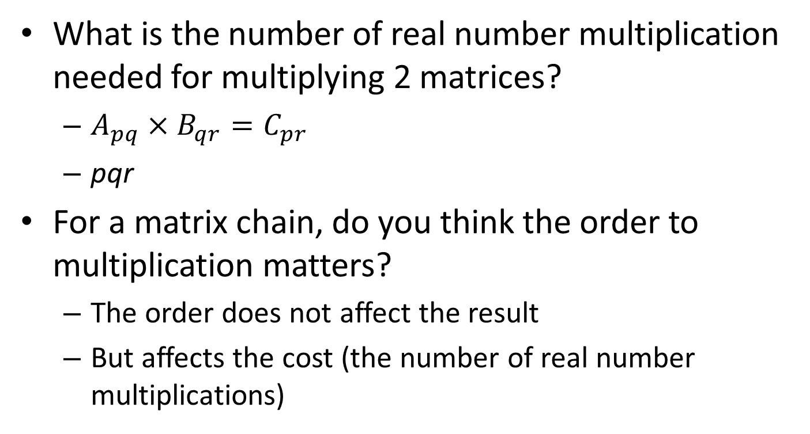



Matrix chain multiplication
What is the number of real number multiplication needed for multiplying 2 matrices?
$A_{pq}×B_{qr}=C_{pr}$
pqr
For a matrix chain, do you think the order to multiplication matters?
The order does not affect the result
But affects the cost (the number of real number multiplications)
(
$$A_{1}$$
(
$$A_{2}$$
$$A_{3}$$
)
)
(
(
$$A_{1}$$
$$A_{2}$$
)
$$A_{3}$$
)

Slide 11
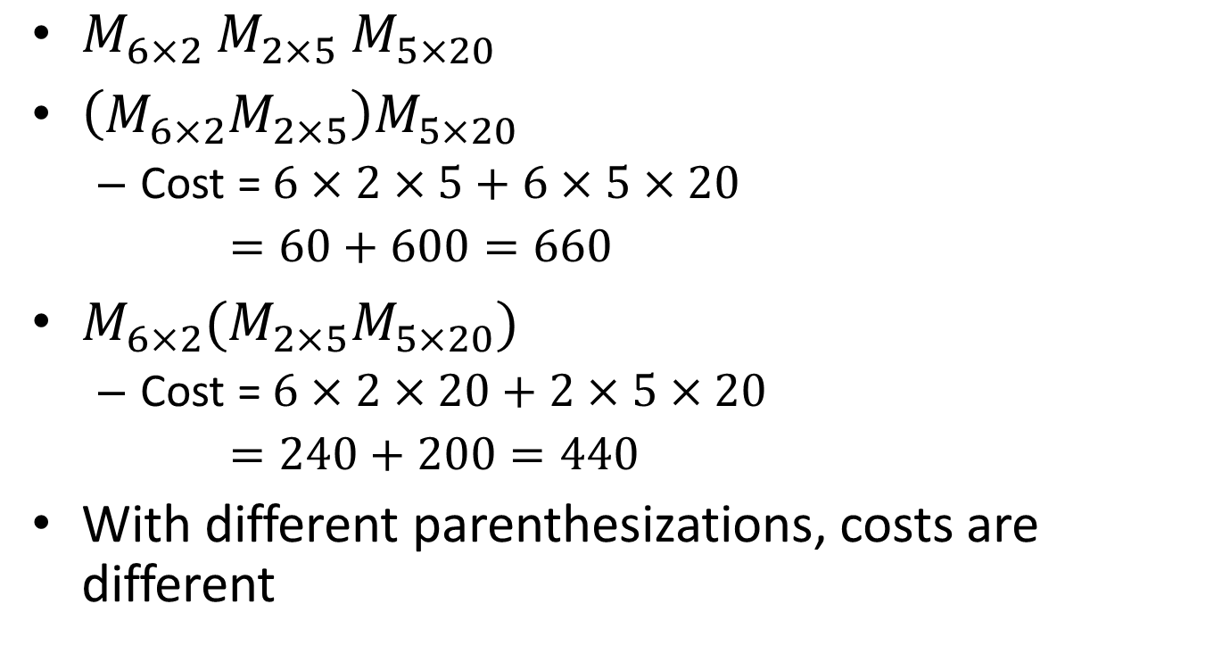
Matrix chain multiplication
$M_{6×2}$ $M_{2×5}$ $M_{5×20}$
$\left(M_{6×2}M_{2×5}\right)M_{5×20}$
Cost = $6×2×5+6×5×20$
$=60+600=660$
$M_{6×2}{(M}_{2×5}M_{5×20})$
Cost = $6×2×20+2×5×20$
$=240+200=440$
With different parenthesizations, costs are different

Slide 12




Matrix chain multiplication
Matrix chain multiplication problem: given a matrix chain, find out a parenthesization with the lowest cost
How to solve it by brute force?
$$A_{1}$$
$$A_{2}$$
$$A_{3}$$
…
$$A_{n}$$

Slide 13




















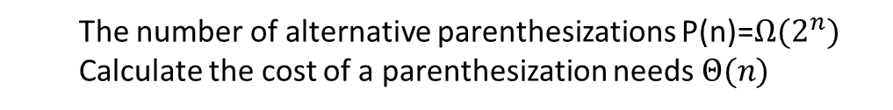
Matrix chain multiplication
How to solve it buy brute force?
(
$$A_{1}$$
(
$$A_{2}$$
(
$$A_{3}$$
$$A_{4}$$
)
)
)
How to divide and conquer?
(
$$A_{1}$$
(
(
$$A_{2}$$
$$A_{3}$$
)
$$A_{4}$$
)
)
Last multiplication is between A1 and A2
(
(
$$A_{1}$$
$$A_{2}$$
)
(
$$A_{3}$$
$$A_{4}$$
)
)
Last multiplication is between A2 and A3
(
(
$$A_{1}$$
(
$$A_{2}$$
$$A_{3}$$
)
)
$$A_{4}$$
)
Last multiplication is between A3 and A4
(
(
(
$$A_{1}$$
$$A_{2}$$
)
$$A_{3}$$
)
$$A_{4}$$
)
The number of alternative parenthesizations P(n)=$Ω(2^{n})$
Calculate the cost of a parenthesization needs $Θ(n)$

Slide 14






















Matrix chain multiplication
How to solve it buy divide-and-conquer?
$$A_{1}$$
$$A_{2}$$
$$A_{3}$$
$$A_{4}$$
$$A_{1}$$
$$A_{2}$$
$$A_{3}$$
$$A_{4}$$
$$A_{1}$$
$$A_{24}$$
optimal cost of + optimal cost of + cost of
$$A_{1}$$
$$A_{2}$$
$$A_{3}$$
$$A_{4}$$
$$A_{12}$$
$$A_{34}$$
optimal cost of + optimal cost of + cost of
$$A_{1}$$
$$A_{2}$$
$$A_{3}$$
$$A_{4}$$
$$A_{13}$$
$$A_{4}$$
optimal cost of + optimal cost of + cost of
Choose the smallest one from them
Weakness?
Many subproblems are overlapped

Slide 15











Matrix chain multiplication
$$A_{1}$$
$$A_{2}$$
$$A_{3}$$
…
$$A_{n}$$
There are n-1 ways to divide it into 2 smaller matrix chains, if divide it after matrix k, for each of them we need to calculate:
$$A_{1}$$
…
$$A_{k}$$
$$A_{k+1}$$
$$…$$
$$A_{n}$$
$$A_{1k}$$
$$A_{k+1,n}$$
optimal cost of + optimal cost of + cost of
Choose the smallest one from them
Many subproblems are overlapped

Slide 16
Matrix chain multiplication
How do it in a dynamic programming way?
Top-down, record the solutions to subproblem
Or, bottom-up, start from smallest problems (the typical manner)
Solve all the possible subproblems
Let’s try it!

Slide 17










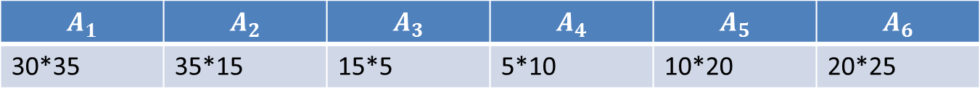














Matrix chain multiplication
$$A_{1}$$ | $$A_{2}$$ | $$A_{3}$$ | $$A_{4}$$ | $$A_{5}$$ | $$A_{6}$$
30*35 | 35*15 | 15*5 | 5*10 | 10*20 | 20*25
 | 1 | 2 | 3 | 4 | 5 | 6
1
2
3
4
5
6
$$A_{1}$$
$$A_{1}A_{2}$$
$$A_{1}{…A}_{3}$$
$$A_{1}{…A}_{4}$$
$$A_{1}{…A}_{5}$$
$$A_{1}{…A}_{6}$$
$$A_{2}$$
$$A_{2}A_{3}$$
$$A_{2}{…A}_{4}$$
$$A_{2}{…A}_{5}$$
$$A_{2}{…A}_{6}$$
$$A_{3}$$
$$A_{3}A_{4}$$
$$A_{3}{…A}_{5}$$
$$A_{3}{…A}_{6}$$
$$A_{4}$$
$$A_{4}A_{5}$$
$$A_{4}{…A}_{6}$$
$$A_{5}$$
$$A_{5}A_{6}$$
$$A_{6}$$
$$A_{i}$$
…
$$A_{j}$$
Table ${Cell}_{ij}$ records the minimal cost of

Slide 18

Matrix chain multiplication
$$A_{1}$$ | $$A_{2}$$ | $$A_{3}$$ | $$A_{4}$$ | $$A_{5}$$ | $$A_{6}$$
30*35 | 35*15 | 15*5 | 5*10 | 10*20 | 20*25
30*35*15=15750
 | 1 | 2 | 3 | 4 | 5 | 6
1
2
3
4
5
6
0
15750
35*15*5=2625
$$A_{1}$$
$$A_{1}A_{2}$$
$$A_{1}{…A}_{3}$$
$$A_{1}{…A}_{4}$$
$$A_{1}{…A}_{5}$$
$$A_{1}{…A}_{6}$$
2625
15*5*10=750
0
$$A_{2}A_{3}$$
$$A_{2}{…A}_{4}$$
$$A_{2}{…A}_{5}$$
$$A_{2}{…A}_{6}$$
$$A_{2}$$
0
750
5*10*20=1000
$$A_{3}$$
$$A_{3}A_{4}$$
$$A_{3}{…A}_{5}$$
$$A_{3}{…A}_{6}$$
0
1000
$$A_{4}$$
$$A_{4}A_{5}$$
$$A_{4}{…A}_{6}$$
10*20*25=5000
0
5000
$$A_{5}$$
$$A_{5}A_{6}$$
0
$$A_{6}$$
$$A_{i}$$
…
$$A_{j}$$
Table ${Cell}_{ij}$ records the minimal cost of

Slide 19






Matrix chain multiplication
$$A_{1}$$ | $$A_{2}$$ | $$A_{3}$$ | $$A_{4}$$ | $$A_{5}$$ | $$A_{6}$$
30*35 | 35*15 | 15*5 | 5*10 | 10*20 | 20*25
$$A_{1}$$
$$A_{2}$$
$$A_{3}$$
 | 1 | 2 | 3 | 4 | 5 | 6
1
2
3
4
5
6
0
15750
7875
,1-2
$$A_{1}{…A}_{4}$$
$$A_{1}{…A}_{5}$$
$$A_{1}{…A}_{6}$$
0+2625+30*35*5=7875
$$A_{1}{…A}_{3}$$
0
2625
$$A_{2}{…A}_{4}$$
$$A_{2}{…A}_{5}$$
$$A_{2}{…A}_{6}$$
$$A_{1}$$
$$A_{2}$$
$$A_{3}$$
0
750
$$A_{3}{…A}_{5}$$
$$A_{3}{…A}_{6}$$
0
1000
$$A_{4}{…A}_{6}$$
15750+0+30*15*5=30825
0
5000
0
$$A_{i}$$
…
$$A_{j}$$
Table ${Cell}_{ij}$ records the minimal cost of

Slide 20






Matrix chain multiplication
$$A_{1}$$ | $$A_{2}$$ | $$A_{3}$$ | $$A_{4}$$ | $$A_{5}$$ | $$A_{6}$$
30*35 | 35*15 | 15*5 | 5*10 | 10*20 | 20*25
$$A_{2}$$
$$A_{3}$$
$$A_{4}$$
 | 1 | 2 | 3 | 4 | 5 | 6
1
2
3
4
5
6
0
15750
7875
,1-2
$$A_{1}{…A}_{4}$$
$$A_{1}{…A}_{5}$$
$$A_{1}{…A}_{6}$$
0+750+35*15*10=6000
2625
4375, 3-4
0
$$A_{2}{…A}_{4}$$
$$A_{2}{…A}_{5}$$
$$A_{2}{…A}_{6}$$
$$A_{2}$$
$$A_{3}$$
$$A_{4}$$
0
750
$$A_{3}{…A}_{5}$$
$$A_{3}{…A}_{6}$$
0
1000
$$A_{4}{…A}_{6}$$
2625+0+35*5*10=4375
0
5000
0
$$A_{i}$$
…
$$A_{j}$$
Table ${Cell}_{ij}$ records the minimal cost of

Slide 21






Matrix chain multiplication
$$A_{1}$$ | $$A_{2}$$ | $$A_{3}$$ | $$A_{4}$$ | $$A_{5}$$ | $$A_{6}$$
30*35 | 35*15 | 15*5 | 5*10 | 10*20 | 20*25
$$A_{3}$$
$$A_{4}$$
$$A_{5}$$
 | 1 | 2 | 3 | 4 | 5 | 6
1
2
3
4
5
6
0
15750
7875
,1-2
$$A_{1}{…A}_{4}$$
$$A_{1}{…A}_{5}$$
$$A_{1}{…A}_{6}$$
0+1000+15*5*20=2500
0
2625
4375, 3-4
$$A_{2}{…A}_{5}$$
$$A_{2}{…A}_{6}$$
$$A_{3}$$
$$A_{4}$$
$$A_{5}$$
0
750
2500, 3-4
$$A_{3}{…A}_{5}$$
$$A_{3}{…A}_{6}$$
0
1000
$$A_{4}{…A}_{6}$$
750+0+15*10*20=3750
0
5000
0
$$A_{i}$$
…
$$A_{j}$$
Table ${Cell}_{ij}$ records the minimal cost of

Slide 22






Matrix chain multiplication
$$A_{1}$$ | $$A_{2}$$ | $$A_{3}$$ | $$A_{4}$$ | $$A_{5}$$ | $$A_{6}$$
30*35 | 35*15 | 15*5 | 5*10 | 10*20 | 20*25
$$A_{4}$$
$$A_{5}$$
$$A_{6}$$
 | 1 | 2 | 3 | 4 | 5 | 6
1
2
3
4
5
6
0
15750
7875
,1-2
$$A_{1}{…A}_{4}$$
$$A_{1}{…A}_{5}$$
$$A_{1}{…A}_{6}$$
0+5000+5*10*25=6250
0
2625
4375, 3-4
$$A_{2}{…A}_{5}$$
$$A_{2}{…A}_{6}$$
$$A_{4}$$
$$A_{5}$$
$$A_{6}$$
0
750
2500, 3-4
$$A_{3}{…A}_{6}$$
0
1000
3500, 5-6
1000+0+5*20*25=3500
$$A_{4}{…A}_{6}$$
0
5000
0
$$A_{i}$$
…
$$A_{j}$$
Table ${Cell}_{ij}$ records the minimal cost of

Slide 23










Matrix chain multiplication
$$A_{1}$$ | $$A_{2}$$ | $$A_{3}$$ | $$A_{4}$$ | $$A_{5}$$ | $$A_{6}$$
30*35 | 35*15 | 15*5 | 5*10 | 10*20 | 20*25
$$A_{1}$$
$$A_{2}$$
$$A_{3}$$
$$A_{4}$$
 | 1 | 2 | 3 | 4 | 5 | 6
1
2
3
4
5
6
,1-2
0
15750
7875
9375, 3-4
$$A_{1}{…A}_{4}$$
$$A_{1}{…A}_{5}$$
$$A_{1}{…A}_{6}$$
0+4375+30*35*10=14875
0
2625
4375, 3-4
$$A_{2}{…A}_{5}$$
$$A_{2}{…A}_{6}$$
$$A_{1}$$
$$A_{2}$$
$$A_{3}$$
$$A_{4}$$
0
750
2500, 3-4
$$A_{3}{…A}_{6}$$
0
1000
3500, 5-6
15750+750+30*15*10=21000
0
5000
$$A_{1}$$
$$A_{2}$$
$$A_{3}$$
$$A_{4}$$
0
7875+0+30*5*10=9375
$$A_{i}$$
…
$$A_{j}$$
Table ${Cell}_{ij}$ records the minimal cost of

Slide 24












Matrix chain multiplication
$$A_{1}$$ | $$A_{2}$$ | $$A_{3}$$ | $$A_{4}$$ | $$A_{5}$$ | $$A_{6}$$
30*35 | 35*15 | 15*5 | 5*10 | 10*20 | 20*25
$$A_{2}$$
$$A_{3}$$
$$A_{4}$$
$$A_{5}$$
 | 1 | 2 | 3 | 4 | 5 | 6
1
2
3
4
5
6
0
15750
7875
,1-2
9375, 3-4
$$A_{1}{…A}_{5}$$
$$A_{1}{…A}_{6}$$
0+2500+35*15*20=13000
2625
4375, 3-4
7125, 3-4
0
$$A_{2}{…A}_{5}$$
$$A_{2}{…A}_{6}$$
$$A_{2}$$
$$A_{3}$$
$$A_{4}$$
$$A_{5}$$
0
750
2500, 3-4
$$A_{3}{…A}_{6}$$
0
1000
3500, 5-6
2625+1000+35*5*20=7125
0
5000
$$A_{2}$$
$$A_{3}$$
$$A_{4}$$
$$A_{5}$$
0
4375+0+35*10*20=11375
$$A_{i}$$
…
$$A_{j}$$
Table ${Cell}_{ij}$ records the minimal cost of

Slide 25












Matrix chain multiplication
$$A_{1}$$ | $$A_{2}$$ | $$A_{3}$$ | $$A_{4}$$ | $$A_{5}$$ | $$A_{6}$$
30*35 | 35*15 | 15*5 | 5*10 | 10*20 | 20*25
$$A_{3}$$
$$A_{4}$$
$$A_{5}$$
$$A_{6}$$
 | 1 | 2 | 3 | 4 | 5 | 6
1
2
3
4
5
6
0
15750
7875
,1-2
9375, 3-4
$$A_{1}{…A}_{5}$$
$$A_{1}{…A}_{6}$$
0+3500+15*5*25=5375
0
2625
4375, 3-4
7125, 3-4
$$A_{2}{…A}_{6}$$
$$A_{3}$$
$$A_{4}$$
$$A_{5}$$
$$A_{6}$$
0
750
2500, 3-4
5375, 3-4
$$A_{3}{…A}_{6}$$
0
1000
3500, 5-6
750+5000+15*10*25=9500
0
5000
$$A_{3}$$
$$A_{4}$$
$$A_{5}$$
$$A_{6}$$
0
2500+0+15*20*25=10000
$$A_{i}$$
…
$$A_{j}$$
Table ${Cell}_{ij}$ records the minimal cost of

Slide 26




















Matrix chain multiplication
$$A_{1}$$ | $$A_{2}$$ | $$A_{3}$$ | $$A_{4}$$ | $$A_{5}$$ | $$A_{6}$$
30*35 | 35*15 | 15*5 | 5*10 | 10*20 | 20*25
$$A_{1}$$
$$A_{2}$$
$$A_{3}$$
$$A_{4}$$
$$A_{5}$$
 | 1 | 2 | 3 | 4 | 5 | 6
1
2
3
4
5
6
,1-2
0+7125+30*35*20=28125
0
15750
7875
9375, 3-4
11875, 3-4
$$A_{1}{…A}_{5}$$
$$A_{1}{…A}_{6}$$
0
2625
4375, 3-4
7125, 3-4
$$A_{2}{…A}_{6}$$
$$A_{1}$$
$$A_{2}$$
$$A_{3}$$
$$A_{4}$$
$$A_{5}$$
0
750
2500, 3-4
5375, 3-4
15750+2500+30*15*20=27250
0
1000
3500, 5-6
$$A_{1}$$
$$A_{2}$$
$$A_{3}$$
$$A_{4}$$
$$A_{5}$$
0
5000
7875+1000+30*5*20=11875
0
$$A_{1}$$
$$A_{2}$$
$$A_{3}$$
$$A_{4}$$
$$A_{5}$$
$$A_{i}$$
…
$$A_{j}$$
9375+0+30*20*25=24375
Table ${Cell}_{ij}$ records the minimal cost of

Slide 27




















Matrix chain multiplication
$$A_{1}$$ | $$A_{2}$$ | $$A_{3}$$ | $$A_{4}$$ | $$A_{5}$$ | $$A_{6}$$
30*35 | 35*15 | 15*5 | 5*10 | 10*20 | 20*25
$$A_{2}$$
$$A_{3}$$
$$A_{4}$$
$$A_{5}$$
$$A_{6}$$
 | 1 | 2 | 3 | 4 | 5 | 6
1
2
3
4
5
6
0
15750
7875
,1-2
9375, 3-4
11875, 3-4
$$A_{1}{…A}_{6}$$
0+5375+35*15*25=18500
2625
4375, 3-4
18125, 3-4
$$A_{2}$$
$$A_{3}$$
$$A_{4}$$
$$A_{5}$$
$$A_{6}$$
0
7125, 3-4
$$A_{2}{…A}_{6}$$
0
750
2500, 3-4
5375, 3-4
2625+3500+35*5*25=10500
0
1000
3500, 5-6
$$A_{2}$$
$$A_{3}$$
$$A_{4}$$
$$A_{5}$$
$$A_{6}$$
0
5000
0
4375+5000+35*10*25=18125
$$A_{2}$$
$$A_{3}$$
$$A_{4}$$
$$A_{5}$$
$$A_{6}$$
$$A_{i}$$
…
$$A_{j}$$
Table ${Cell}_{ij}$ records the minimal cost of
7125+0+35*20*25=24625

Slide 28






























Matrix chain multiplication
$$A_{1}$$ | $$A_{2}$$ | $$A_{3}$$ | $$A_{4}$$ | $$A_{5}$$ | $$A_{6}$$
30*35 | 35*15 | 15*5 | 5*10 | 10*20 | 20*25
$$A_{1}$$
$$A_{2}$$
$$A_{3}$$
$$A_{4}$$
$$A_{5}$$
$$A_{6}$$
 | 1 | 2 | 3 | 4 | 5 | 6
1
2
3
4
5
6
0+18125+30*35*25=44375
,1-2
0
15750
7875
9375, 3-4
11875, 3-4
15125, 3-4
$$A_{1}{…A}_{6}$$
$$A_{1}$$
$$A_{2}$$
$$A_{3}$$
$$A_{4}$$
$$A_{5}$$
$$A_{6}$$
0
2625
4375, 3-4
7125, 3-4
18125, 3-4
0
750
2500, 3-4
5375, 3-4
15750+5375+30*15*25=32375
0
1000
3500, 5-6
$$A_{1}$$
$$A_{2}$$
$$A_{3}$$
$$A_{4}$$
$$A_{5}$$
$$A_{6}$$
0
5000
7875+3500+30*5*25=15125
0
$$A_{1}$$
$$A_{2}$$
$$A_{3}$$
$$A_{4}$$
$$A_{5}$$
$$A_{6}$$
$$A_{i}$$
…
$$A_{j}$$
9375+5000+30*10*25=21875
Table ${Cell}_{ij}$ records the minimal cost of
$$A_{1}$$
$$A_{2}$$
$$A_{3}$$
$$A_{4}$$
$$A_{5}$$
$$A_{6}$$
11875+0+30*20*25=26875

Slide 29







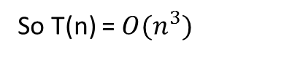
Matrix chain multiplication
 | 1 | 2 | 3 | 4 | 5 | 6
1
2
3
4
5
6
0
15750
7875, 1-2
9375, 3-4
11875, 3-4
15125, 3-4
0
2625
4375, 3-4
7125, 3-4
18125, 3-4
0
750
2500, 3-4
5375, 3-4
0
1000
3500, 5-6
0
5000
0
(
$$A_{1}$$
(
$$A_{2}$$
$$A_{3}$$
)
)
(
(
$$A_{4}$$
$$A_{5}$$
)
$$A_{6}$$
)
Time complexity?
Number of subproblems = $\frac{n\left(n−1\right)}{2}=O(n^{2})$
When all sub solutions are known, time needed for a solution=O(n)
So T(n) = $O(n^{3})$

Slide 30
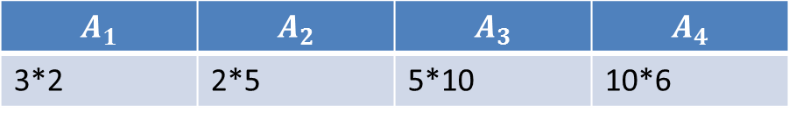
Matrix chain multiplication
$$A_{1}$$ | $$A_{2}$$ | $$A_{3}$$ | $$A_{4}$$
3*2 | 2*5 | 5*10 | 10*6
5 minutes, try it now …
 | 1 | 2 | 3 | 4
1 | 0 | 30 | 160, 1-2 | 256, 1-2
2 |  | 0 | 100 | 220, 3-4
3 |  |  | 0 | 300
4 |  |  |  | 0

Slide 31
How to design a dynamic programming algorithms?
Precondition: subproblems are largely overlapped
Define the optimal solution by optimal subsolutions
Compute the value of an optimal solution
Construct an optimal solution from computed information

Slide 32








Longest common subsequence
Z is a subsequence of A:
All elements in Z are also in A
The order of elements in Z is the same as the corresponding ones in A
E.g. Given A:
B
D
$$C$$
$$A$$
$$B$$
$$A$$
Subsequences:
B
$$C$$
$$A$$
D
$$C$$
$$B$$
$$A$$
…

Slide 33















Longest common subsequence
C is a common subsequence of A and B:
C is a subsequence of A and C is a subsequence of B
E.g. Given A:
B
D
$$C$$
$$A$$
$$B$$
$$A$$
B:
A
B
$$C$$
$$B$$
$$D$$
$$A$$
$$B$$
Common subsequences:
B
$$C$$
$$A$$
$$B$$
$$A$$
B
$$C$$
$$B$$
$$A$$
…

Slide 34











Longest common subsequence
Longest common subsequence (LCS): longest common subsequences
E.g. Given A:
B
D
$$C$$
$$A$$
$$B$$
$$A$$
B:
A
B
$$C$$
$$B$$
$$D$$
$$A$$
$$B$$
LCS:
B
$$C$$
$$B$$
$$A$$

Slide 35
Longest common subsequence
LCS problem: given 2 sequences (e.g. A and B), find a longest common subsequence
How to design this algorithm?
Brute-force
Divide-and-conquer
Dynamic-programming

Slide 36
Longest common subsequence
Brute-force
Find all the common sequences
Find all the subsequence of A
Test each of them if it also a subsequence of B
MAXIMUM(all common subsequences)

Slide 37


























Longest common subsequence
$$A_{1}$$
$$…$$
$$A_{m}$$
Divide-and-conquer
if(m==0 or n==0 ) return “”;
if($A_{m}$= $B_{n}$)
return LCS( , ) + ;
return max(
LCS( , ),
LCS( , ) );
$$B_{1}$$
$$…$$
$$B_{n}$$
$$A_{1}$$
$$…$$
$$A_{m−1}$$
$$B_{1}$$
$$…$$
$$B_{n−1}$$
$$A_{m}$$
$$A_{1}$$
$$…$$
$$A_{m−1}$$
$$B_{1}$$
$$…$$
$$B_{n}$$
$$A_{1}$$
$$…$$
$$A_{m}$$
$$B_{1}$$
$$…$$
$$B_{n−1}$$

Slide 38














Longest common subsequence
$$A_{1}$$
$$…$$
$$A_{m}$$
Dynamic programming
Calculate LCS for ,
from i=0 to m, j=0 to n
the length of LCS is indicated by c[i,j]
Algorithm
if(i==0 or j==0) c[i, j]=0;
else if ( == ) c[i,j]=c[i-1, j-1]+1;
else c[i,j]=max(c[i-1, j], c[i, j-1])
$$B_{1}$$
$$…$$
$$B_{n}$$
$$A_{1}$$
$$…$$
$$A_{i}$$
$$B_{1}$$
$$…$$
$$B_{j}$$
$$A_{i}$$
$$B_{j}$$

Slide 39
Longest common subsequence
Compute the value of a optimal solution:
 | i | 0 | 1 | 2 | 3 | 4
j |  |  | B | D | C | A
0
1 | A
2 | B
3 | C
4 | B
0
0
0
0
0
0
0
0
0
1
0
1
1
1
1
0
1
1
2
2
0
1
1
2
2

Slide 40
Longest common subsequence
Construct the optimal solution:
 | i | 0 | 1 | 2 | 3 | 4
j |  |  | B | D | C | A
0
1 | A
2 | B
3 | C
4 | B
0
0
0
0
0
0
0
0
0
1
0
1
1
1
1
0
1
1
2
2
0
1
1
2
2

